Slide 1
Fragile Families Challenge

Slide 2
Goal
The Fragile Families Survey followed approximately 5000 families for 15 years and surveyed parents and children at ages: birth, 1, 3, 5, 9, and 15.
On the final survey, information on 6 predictive key indicators were collected: GPA, Grit, Material Hardship, Layoffs, Eviction, and Job Training
Using the surveys, the goal is to build a model to predict these 6 outcomes. By seeing which features are most important, it is hoped that future interventions can be planned to assist vulnerable and disadvantaged youths.

Slide 3
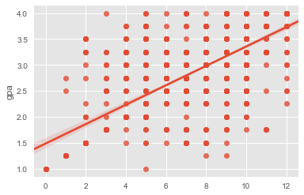
GPA Analysis
Although GPA can be thought of as continuous, it is also categorical – there are only a limited number of GPA’s possible. Using a classifying model was actually more accurate in predicting GPA.
70% accuracy was achieved with only 6 features. Mother’s age and economic status was most important.
Actual vs Predicted GPA

Slide 4
Job Training Analysis
 | precision | recall | F1-score | Support
0 | 0.77 | 0.90 | 0.83 | 372
1 | 0.26 | 0.13 | 0.17 | 111
avg | 0.66 | 0.72 | 0.68 | 483
Job training is a case where the number of positive examples is small compared to the number of negative examples (about a 1/5- 4/5 split).
The model was able to label 72% of cases accurately, but struggled to get the positives correctly, as it tended to over estimate as negative.

Slide 5
Next Steps
There are still 12,000 other features that could be explored.
Many will not be very helpful, and others will need to be transformed or have missing data dealt with.
But, it is hoped that including additional features may lead to a more robust model.
Additionally, the other 4 outcomes will be tested and modeled.

